Slide 1
Concepts of this proj - CPU Base -
Justin

Slide 2
Index
HPC
What is HPC?
Flattening
Quantization
Example
Tensor
Image Vectorization
Embedding Space
General
Visualization
In this proj.
Searching algorithm in Vector Space
Cosine Similarity & L2 Normalization
Gaussian Whitening
Mathematical error when we add XY Axis
Project Pipeline
What else can you make with these?

Slide 3
What is HPC (High-Performance Computing)?
HPC, Extreme Optimization in Reality
HPC is not just about writing clean code; it is the practice of completing computations as fast as physically possible by any means necessary, deeply utilizing the underlying hardware.
Make it faster and lighter

Slide 4
What is HPC cont. (examples_1)
The Illusion of Big-O Notation:
In computer science theory, an O(log n) algorithm is always considered "faster" than an O(n) or O(n^2) algorithm.
However, theory ignores the hidden constant factors (e.g., memory allocation time, CPU cache utilization, data types, and language overhead).
Theory vs. Reality (The HPC Mindset):
In HPC, we don't blindly trust Big-O. If calculating the actual execution time on our specific hardware proves that an O(n^2) algorithm finishes faster than an O(log n) algorithm for our specific data size, we choose the O(n^2) algorithm.

Slide 5
What is HPC cont. (examples_2)
Real-World Example: Array vs. Linked List:
Theory: Inserting data into a Linked List is O(1), while an Array is O(n). The List should always be faster.
HPC Reality: Because Arrays use contiguous memory, they perfectly utilize the CPU's L1/L2 cache. For datasets at least under 10,000 items, the Array's hardware efficiency completely crushes the List's pointer-chasing overhead. The "slower" O(n) Array is practically much faster until the dataset grows massively.
Conclusion: HPC is about understanding these crossover points and tailoring the architecture to the exact constraints of our system.
Details → https://stackoverflow.com/questions/13174339/vector-vs-list-according-to-stroustrup

Slide 6
What is HPC? cont.
In this Project, HPC will be applied as…
CPU (Sequential Processing)
Analogy: A few genius-level workers.
Limitation: With only a few cores, it processes data sequentially (one by one). Running a for loop on 15 frames of 1080p video (approx. 90 million data points) creates a severe memory bottleneck.
HPC & GPU (Parallel Processing)
Analogy: Thousands of average workers.
Solution: We slice the data into thousands of tiny chunks and assign them simultaneously to the thousands of cores inside GPU. This architecture compresses computation time from minutes down to fractions of a second.

Slide 7
HPC – Flattening (Restructuring Memory)
Flattening (Restructuring Memory)
The Problem: Computer memory (RAM / VRAM) is a 1D linear structure, not 3D. Reading an image 3D array (Width x Height x RGB) directly causes severe cache misses.
The Solution: We destroy the original 3D shape and stretch the image into a single, massive 1D Array (Vector).
The Effect: This enables Coalesced Memory Access. The thousands of GPU cores can sweep through the data continuously in a single cycle, maximizing throughput.

Slide 8
HPC – Quantization (Data Compression)
The Problem: Standard programming numbers (float32) consume massive VRAM and PCIe bandwidth.
The Solution: We cast the raw pixel data into 8-bit integers (uint8) since RGB values only range from 0 to 255.
The Effect: This simple type-casting shrinks the memory footprint and transfer time by exactly 75%, a crucial optimization for computer.

Slide 9
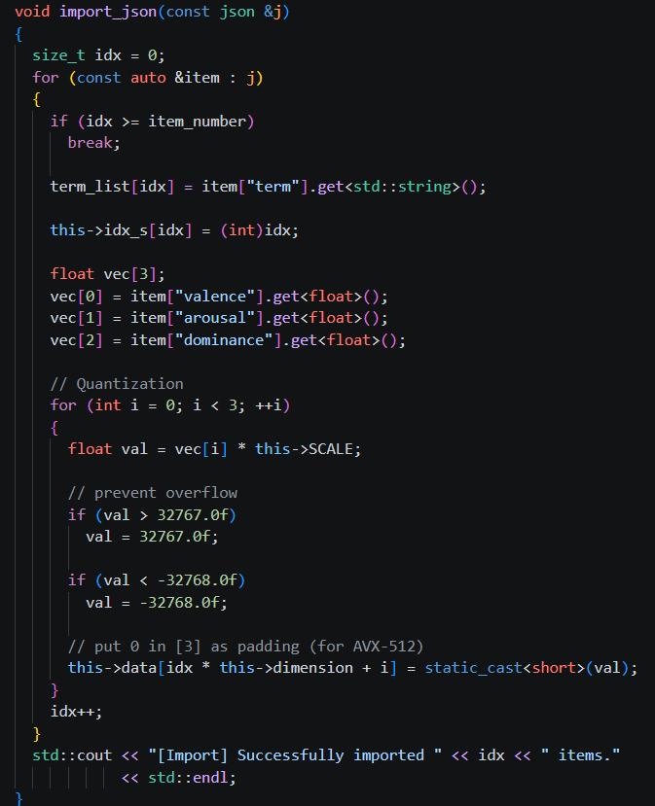
HPC - Example
1. Quantization
Replaced standard 32-bit float with 16-bit short (Int16).
Result: Cuts memory footprint and bandwidth requirements by exactly 50%.
2. Flattening (1D Array)
We refuse to use nested structures like vector<vector>. We calculate the absolute total size to enforce a single, contiguous 1D memory block.

Slide 10
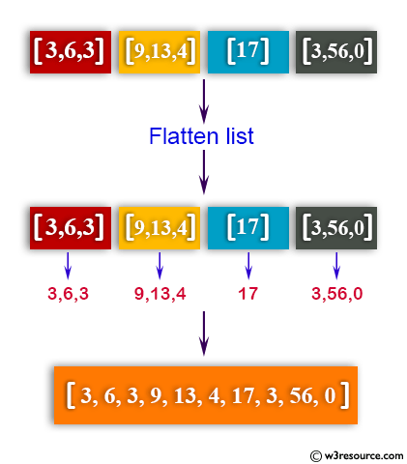
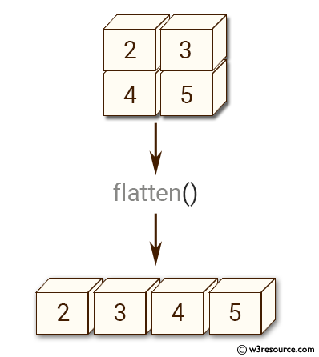
HPC – Concepts Simplified
Flattening

Slide 11
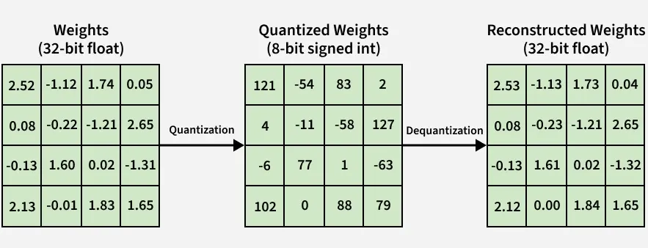
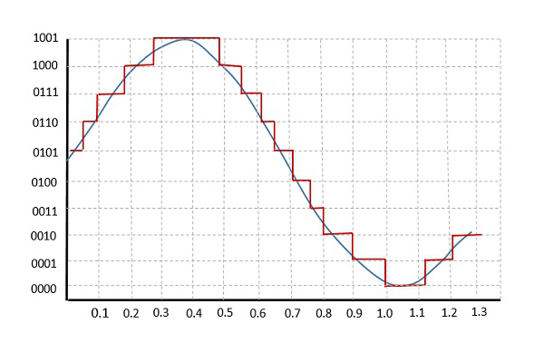
HPC - Example Simplified
Quantization

Slide 12
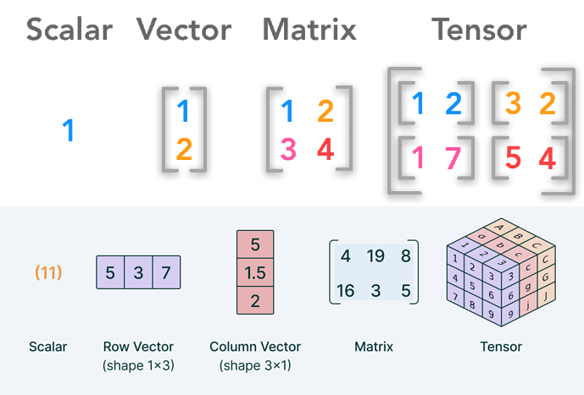
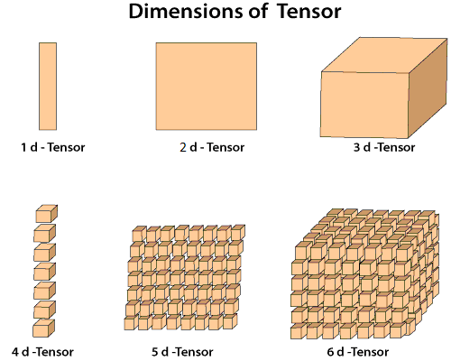
Tensor

Slide 13
Tensor cont.
Int x → scalar
Int x = {} → array(vector, 1D tensor)
vector<vector<int>> → 2D array (matrix, 2D tensor)
Vector<vector<vector<int>>> → 3D array (3D tensor)
….-> nD tensor
→ If you can use array, it also means you can handle tensor too!
So, AI framework TensorFlow means, a lib that makes handling n-D dimension calculation easier(kinda).

Slide 14
Tensor cont.
Why are we using tensor for this project? → A single chunk of video is actually a massive 4D Tensor data structure: N (Frames) x Height x Width x 3(RGB). To handle this terrifying amount of data efficiently, we need to know how to "flatten" this 4D tensor into a 1D array. Understanding this "Tensor" concept is the only way we can mathematically calculate and extract the core "Image Vector" without melting our CPUs and GPUs.

Slide 15
Image Vectorization
Image Vectorization (From Memory to Math)
The Paradigm Shift:
Flattening is a hardware concept (organizing memory for the GPU or CPU)
Vectorization is a mathematical concept. Once flattened, the image is no longer a "picture"; it is a pure mathematical Vector.

Slide 16
Image Vectorization cont.
What is a Vector in this context?
A single number represents a point on a 1D line.
Two numbers (X, Y) represent a point on a 2D plane.
Therefore, a flattened frame with 150,528 numbers (224 x 224 x 3) is exactly one single coordinate point in a 150,528-dimensional mathematical space.
Why do we do this?
Computers cannot "see" images or understand pixels.
However, computers are incredibly fast at calculating geometry. By turning an image into a point in space, we can easily calculate distances and angles to compare them.

Slide 17

Image Vectorization - visualization
D_1
Image’s Vector points A
[ 124, 45, 210, 0, 18, ... , 255 ]
Flattened Array
A
Computer can understand an image now!
D_3
D_2
A Single Frame in Vector Space

Slide 18
Embedding Space - General
What is an Embedding Space?
1. The Universal Translator (General Definition):
Computers are "Number Crunchers." They cannot understand the concept of a 'Cat', a 'Word', or a 'Video’.
Embedding is the process of translating these human concepts into a language computers love: Vectors (Lists of numbers).
The Embedding Space is the digital map where these translated concepts live.

Slide 19
Embedding Space - General
2. The Law of Geometry (Similarity = Distance):
In the real world, we say "Apple and Pear are similar.“
In an Embedding Space, we say "The distance between the Apple vector and the Pear vector is small.“
This allows us to perform Calculus on Meanings. We can add, subtract, and find the average of images just by using their coordinates.
3. Feature Mapping:
Each axis in this space represents a specific "Feature" (though in high-dimensional space, these features are often too complex for humans to name).
By placing data in this space, we turn Visual Recognition into a Simple Geometry Problem.

Slide 20
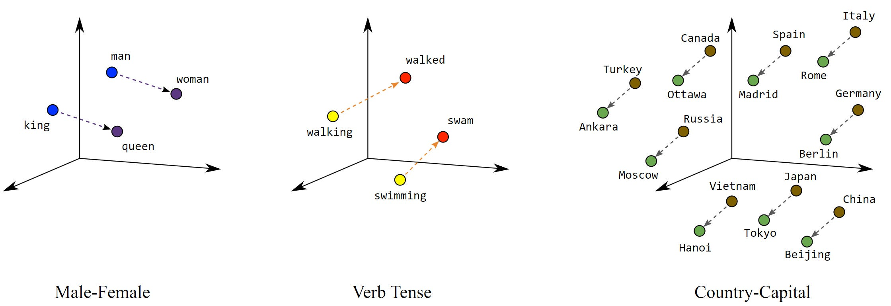
Embedding Space – Visualization
Far distance = less relevant
Near distance = more relevant

Slide 21
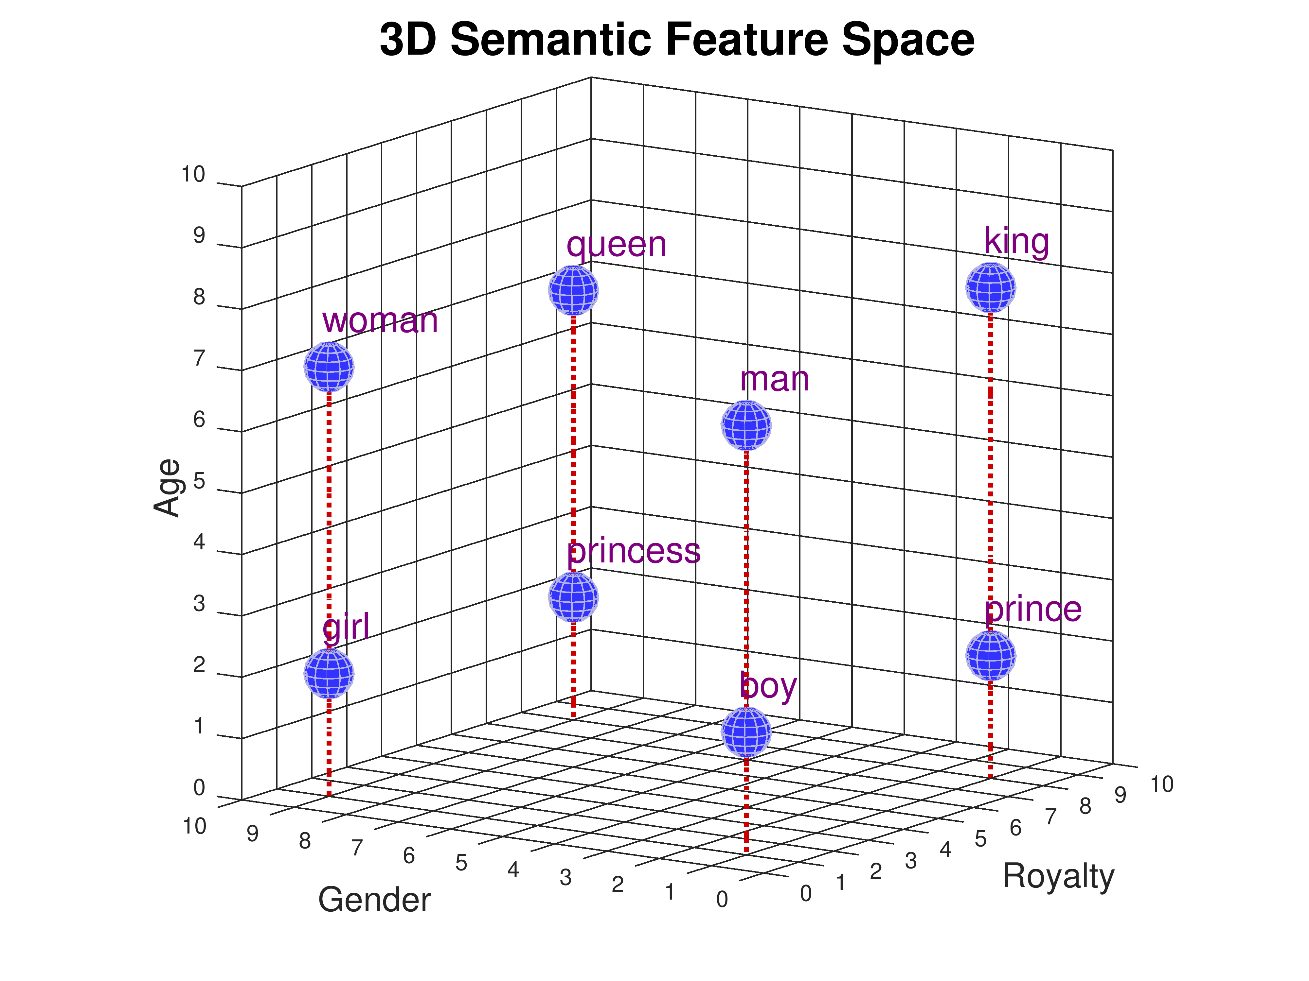
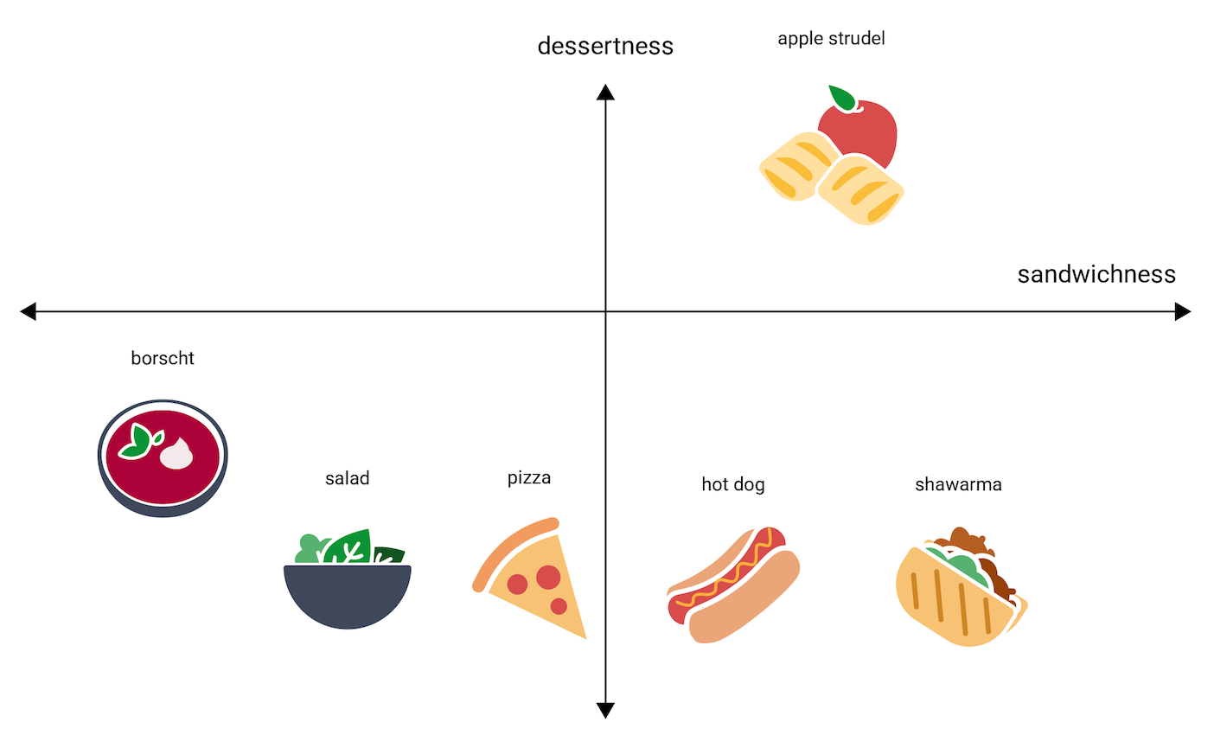
Embedding Space - Visualization
Computer understands words, contexts, or images in this way!

Slide 22
Embedding Space – In this proj.
Meaning in Our Project (The Application):
Our Universe: A massive mathematical space created by our flattened 1D arrays (e.g., 150,528 dimensions).
The Cluster: When we process 0.5 seconds of video, we plot exactly 15 points into this space. Because they are consecutive frames, they naturally group together to form a localized "Cloud" (Cluster).
The Ultimate Goal: By calculating the absolute center (Centroid / Mean Vector) of this 15-point cloud, we find the mathematical "average" of that 0.5-second moment. The real frame closest to this center is our optimal Keyframe.

Slide 23
Searching algorithm in Vector Space
So, How can we find key frame among 15 frames?
Searching the Space: Finding the "True" Keyframe
Step 1: The "Ghost" Frame (Mean Vector)
We calculate the arithmetic mean of the 15 frames in our cluster.
However, this Mean Vector is a mathematical illusion (a blurry mix of 15 frames). We cannot show this to the user. We must find a Real Frame that is closest to this center.

Slide 24
Searching algorithm in Vector Space
Step 2: How do we measure "Close"? (Cosine Similarity)
The Metric: We use Cosine Similarity to measure the Angle between the Mean Vector and the Real Frame Vectors, ignoring their length (magnitude).
Why Angle? (Robustness): In image processing, the "length" of a vector often represents overall brightness, while the "direction" represents the actual pattern (shapes/colors).
By measuring only the angle, our algorithm can recognize that two frames show the exact same scene, even if one is slightly darker than the other.

Slide 25
Cosine Similarity & L2 Normalization
Searching Algorithms: Speed & Efficiency
Method 1: Cosine Similarity & L2 Distance
How it works: Directly calculates the angle (Cosine) or straight-line distance (L2) between the Mean Vector and frame vectors.
Performance: Blazingly fast. Perfectly optimized for our C++ CPU architecture (utilizing hardware SIMD instructions).
Pros: Ideal for massive datasets or real-time processing where speed is the absolute priority.
Cons: Treats all pixel data equally, meaning static background pixels might overpower the important moving objects.

Slide 26
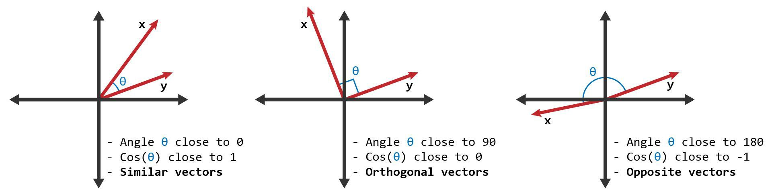
Cosine Similarity & L2 Normalization
Cosine Similarity

Slide 27
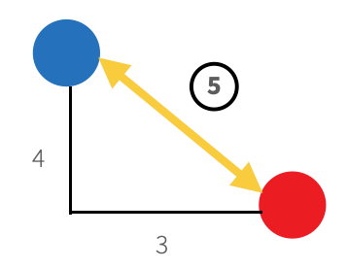
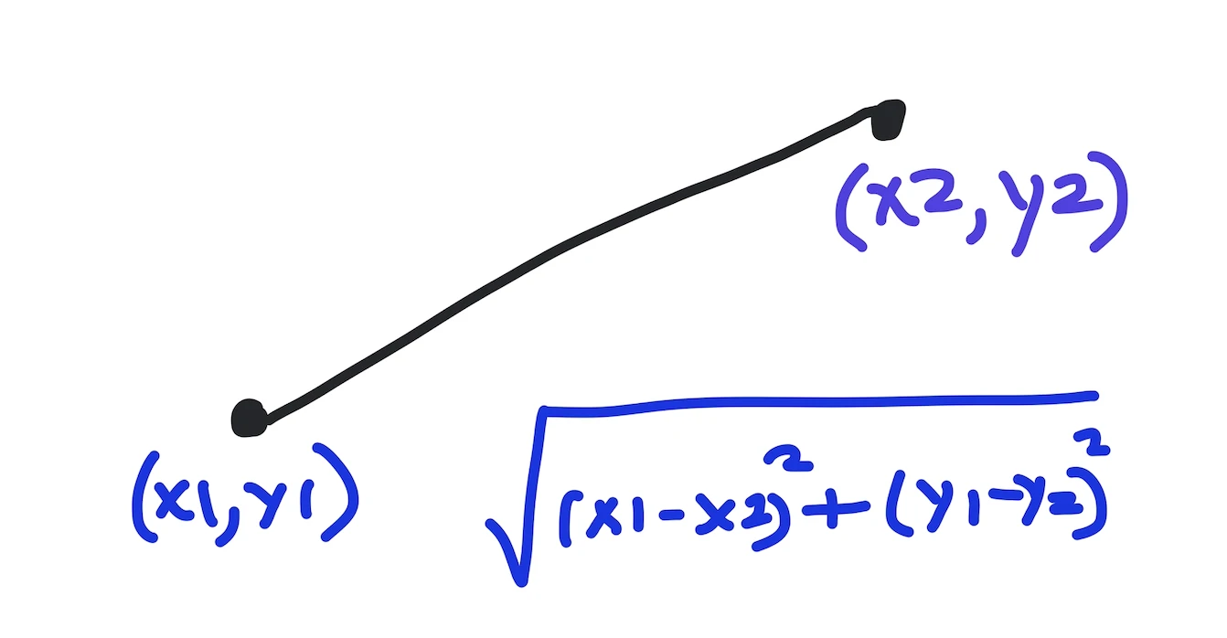
Cosine Similarity & L2 Normalization
L2 Normalization
Just finding the smallest distance

Slide 28
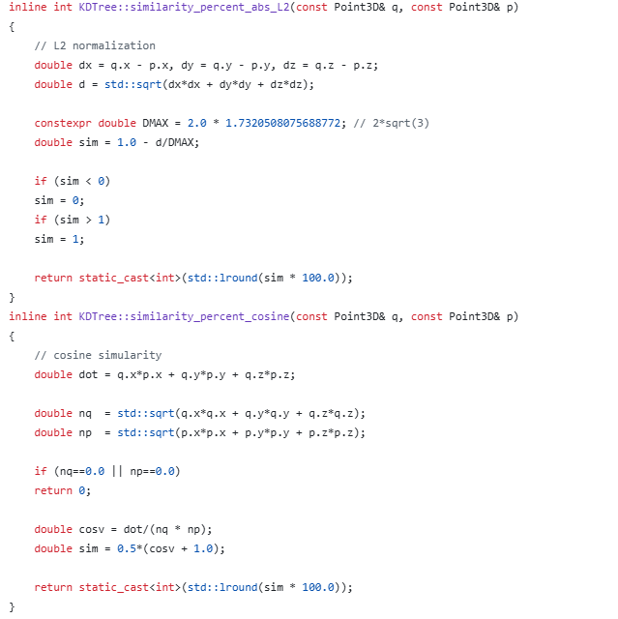
Cosine Similarity & L2 Normalization

Slide 29
Mathematical Error (The XY Coordinate Trap)
Critical Pitfall - The XY Coordinate Trap
The Illusion of 5D Tensors:
It seems logical to add spatial coordinates (X, Y) to the RGB data to create a 5D Tensor [R, G, B, X, Y].
Hypothesis: The computer will know exactly where the colors are located on the screen.
The Mathematical Collapse:
Scale Imbalance: RGB values fluctuate slightly between 0 and 255. However, X and Y coordinates are massive absolute constants (e.g., 0 to 1920).
The Dominance Effect: In distance calculations (like Cosine or L2), the massive X and Y constants completely overpower the tiny RGB variations.

Slide 30
Mathematical Error (The XY Coordinate Trap)
The Disastrous Result:
The algorithm will look at a completely Black frame and a completely White frame and conclude: "Because their XY coordinate arrays are identical, these two frames are 99.9% identical.“
Conclusion: We must flatten pure pixel data (RGB only) to maintain mathematical integrity in the embedding space.

Slide 31
Project Pipeline
The Full C++ Pipeline (From Video to Keyframe)
Decoding (OpenCV / FFmpeg):
Extract raw 3D pixel arrays (RGB) from the compressed .mp4 file.
HPC Memory Prep:
Quantization: Cast 32-bit floats to 16-bit/8-bit integers to halve memory usage.
Flattening: Stretch the 3D arrays into massive contiguous 1D Vectors (150,528 dimensions).
Space Mapping:
Plot 15 consecutive frames (0.5s segment) into the high-dimensional Embedding Space.
Calculus on Meanings:
Calculate the Centroid (Mean Vector) of the 15-frame cluster.
Precision Search:
Apply Gaussian Whitening (to kill background noise → I’ll handle it).
Run Cosine Similarity to find the real frame closest to the Centroid.
Result: The perfect Keyframe is extracted!

Slide 32
What else can you make with these?
Beyond Keyframes - What else can we build?
1. Reverse Video Search Engine: Input a single photo, vector-match it against millions of flattened database frames, and instantly find the exact timestamp in a movie.
2. Automated Highlight Reel Generation: Find the "Outliers" (vectors that suddenly jump far away) to instantly detect explosions, scene changes, or high-action moments.
3. Real-time Semantic Compression: Throw away frames that are mathematically too close to each other, compressing a 60fps video down to 5fps without losing any meaningful visual information.
4. Build a Native AI Image Classifier from Scratch: By applying this exact architecture (Flattening → Embedding → Cosine Search), we can build a foundational AI (k-NN Classifier). We can categorize images using pure C++ math, entirely independent of heavy frameworks like TensorFlow or PyTorch.

